Slide 1
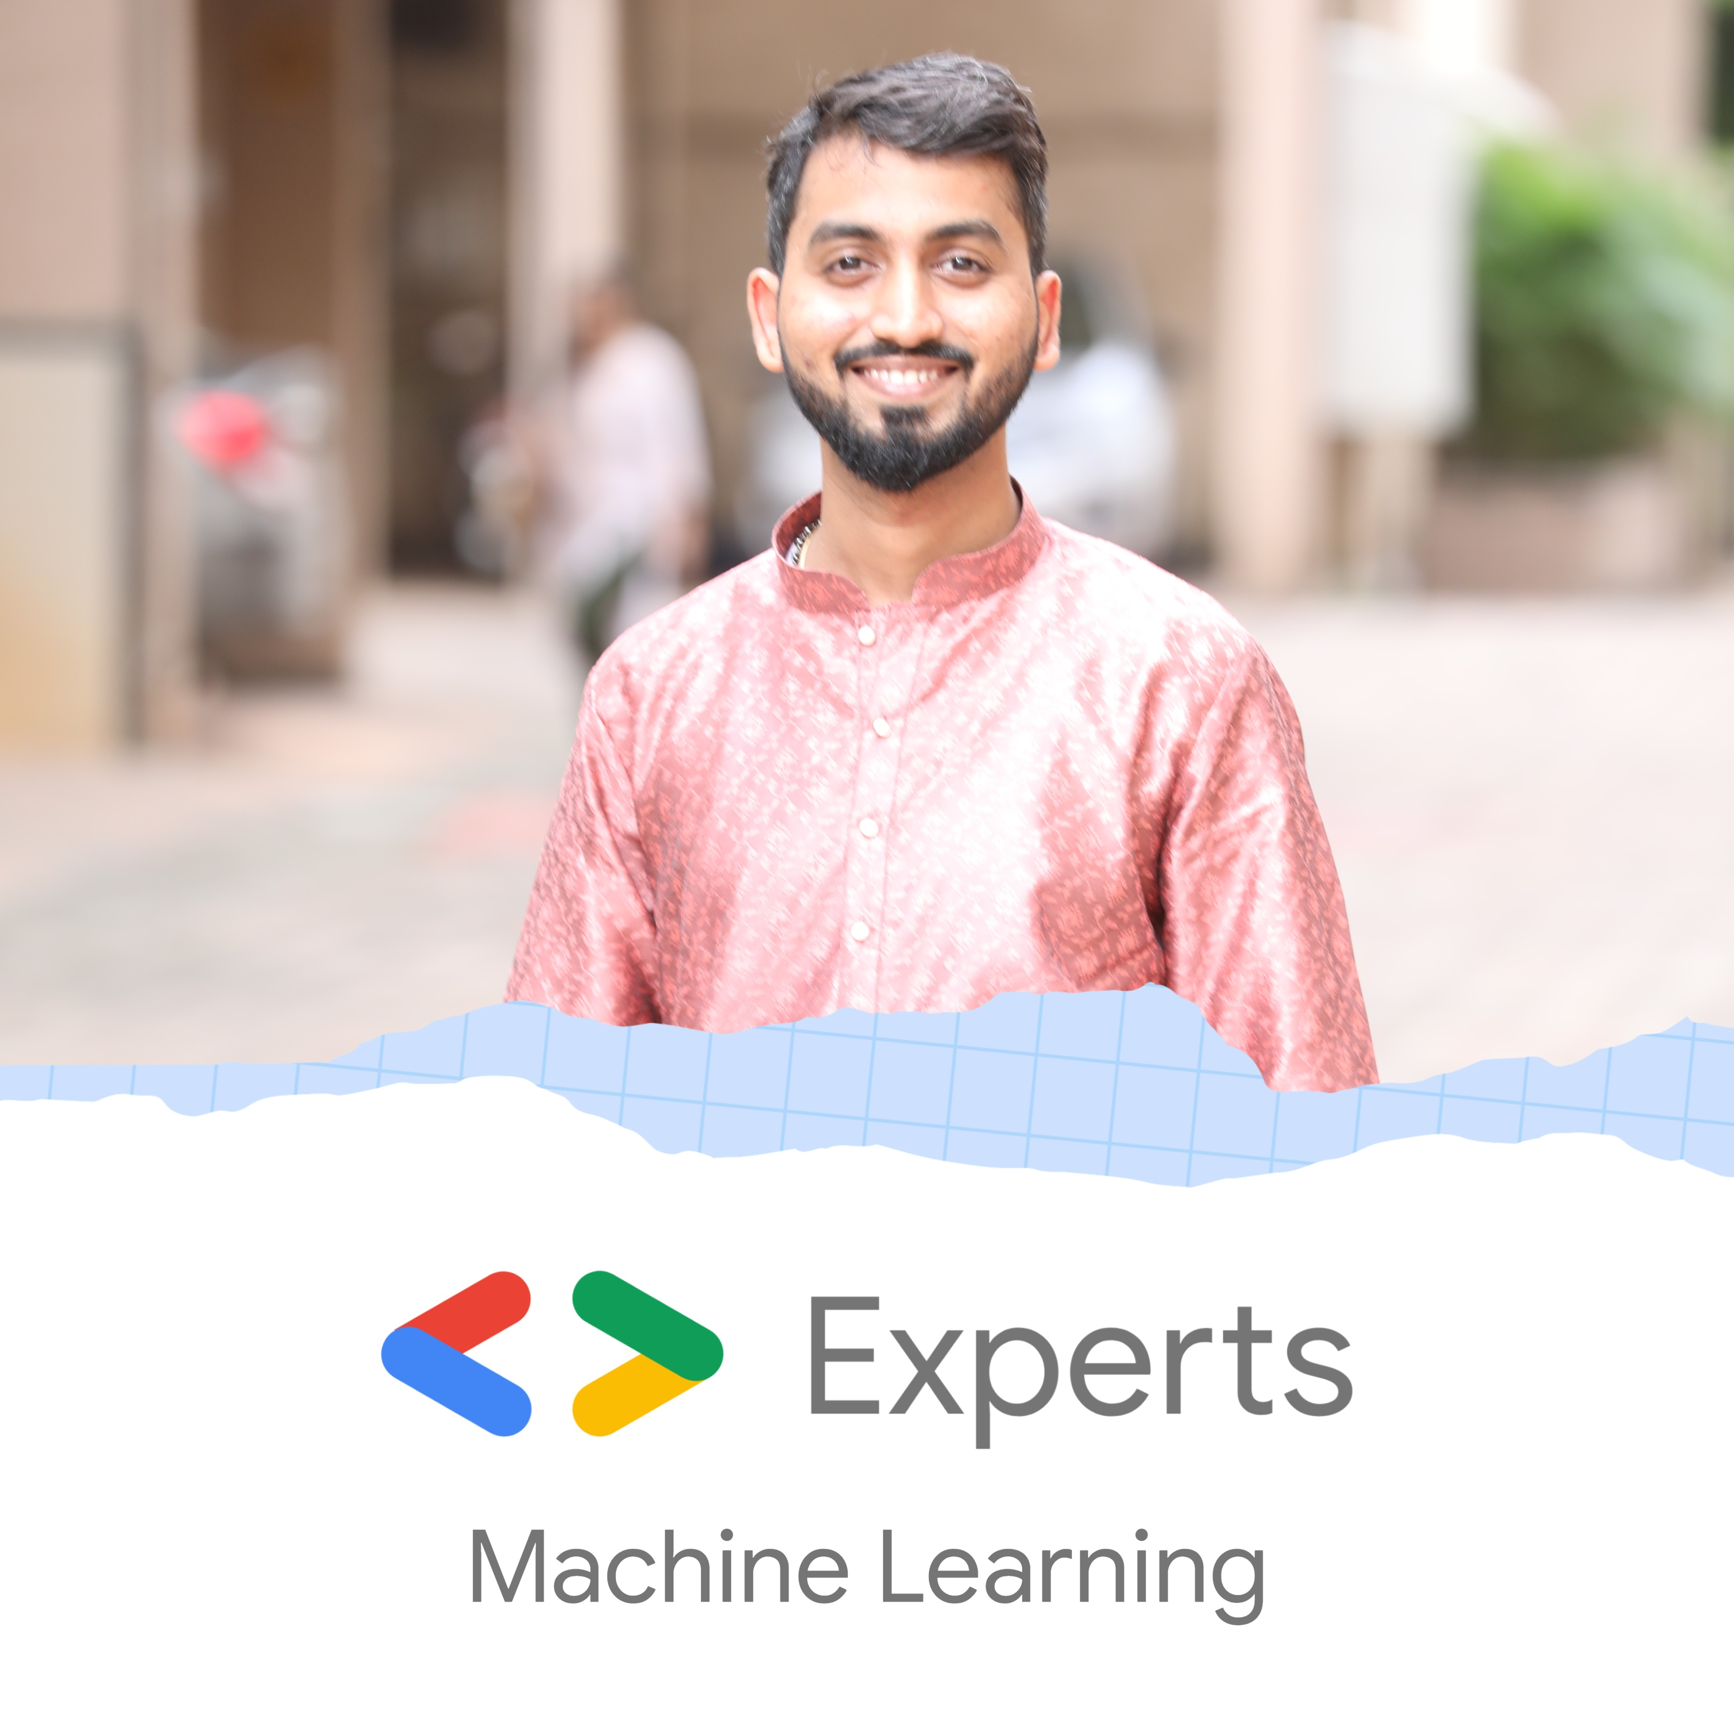

Exploring the power of Cloud Vision API
Nitin Tiwari
Google Developer Expert – Machine Learning Software Engineer @ LTIMindtree

Slide 2
$whoami
Software Engineer at LTIMindtree
Google Developer Expert in Machine Learning
Technical speaker; talks across India and South East Asia
Contributor to Google Dev Library
Love writing blogs on AI/ML

Slide 3
Content
Introduction to Google Cloud Platform
Cloud Vision API
Hands-on Lab: Detect Labels, Faces, and Landmarks in Images
Google Cloud Certifications
Resources

Slide 4
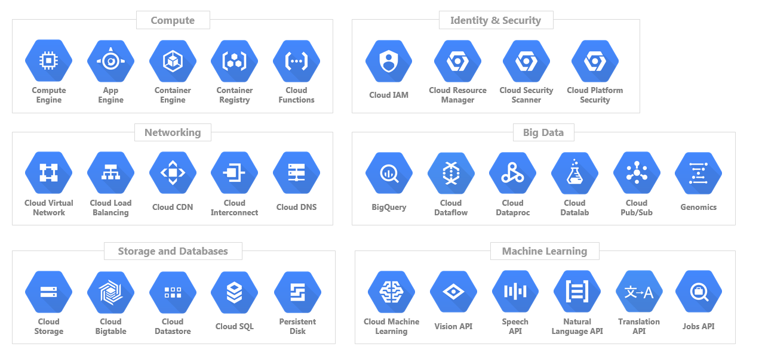
Google Cloud Platform
Google Cloud Platform (GCP) is a suite of cloud computing services such as Compute, Identity & Security, Networking, Big Data, Storage & Database, Machine Learning, etc.

Slide 5
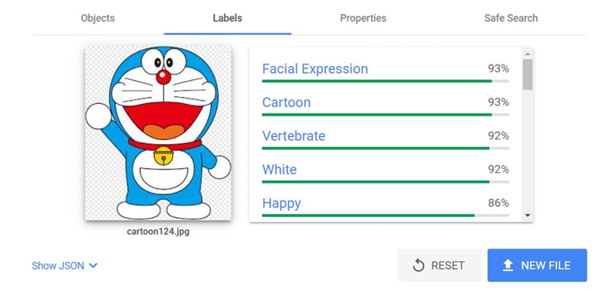
Cloud Vision API
The Vision API allows developers to easily integrate vision detection features within applications, including image labeling, face, landmark detection, optical character recognition (OCR), and tagging of explicit content.
Try it yourself:
https://cloud.google.com/vision/docs/drag-and-drop

Slide 6
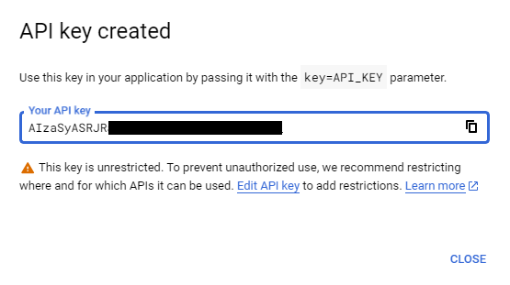
Hands-on Lab
Step 1: Set up your GCP project
Open the Cloud Shell and type the commands:
gcloud auth list
gcloud config list project
Step 2: Create an API key
Open the navigation menu > APIs & Services > Credentials > + Create Credentials > API key
Copy the API key and type the following command in the Cloud Shell.
export API_KEY = YOUR_API_KEY

Slide 7
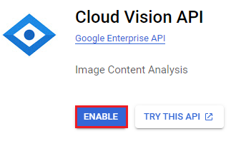
Step 3: Enable the Cloud Vision API
Open the navigation menu > APIs & Services > Enabled APIs & services > + ENABLE APIS AND SERVICES > Cloud Vision API
> Enable

Slide 8
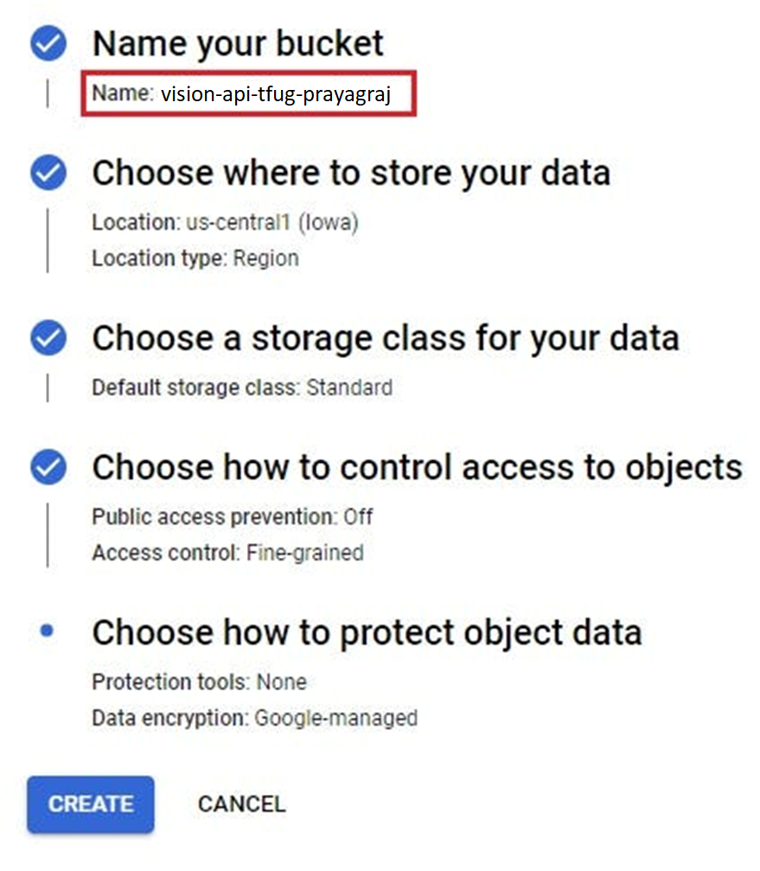
Step 4: Create a Cloud Storage Bucket
Open the navigation menu > Cloud Storage > Buckets > + Create

Slide 9
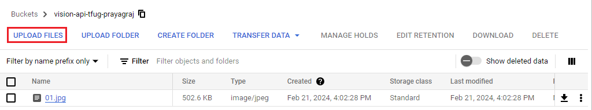
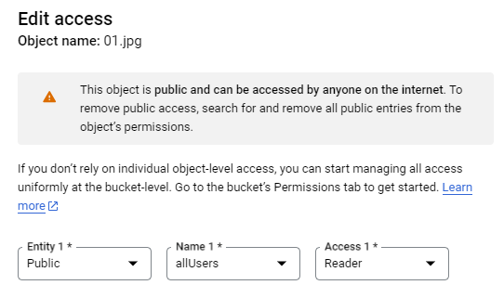
Step 5: Add some images to the bucket
Step 6: Edit access to images
Click on the three vertical dots button > Edit access > Configure the entity, name, and access options as follows:

Slide 10
Step 7: Create a request body
Open the Cloud Shell and type the following:
echo '
{
"requests": [
{
"image": {
"source": {
"gcsImageUri": "gs://YOUR_BUCKET_NAME/YOUR_IMAGE_NAME"
}
},
"features": [
{
"type": "LABEL_DETECTION",
"maxResults": 5
}
]
}
]
}
' > request.json

Slide 11
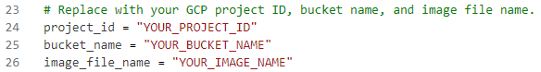
Step 8: Hit a request to Cloud Vision API
Open the Cloud Shell and type the following command:
curl -s -X POST -H "Content-Type: application/json" --data-binary @request.json https://vision.googleapis.com/v1/images:annotate?key=${API_KEY}
Step 9: Clone the repository
Open the Cloud Shell and type the following commands:
pip install Pillow
git clone https://github.com/NSTiwari/Vision-API-on-Google-Cloud-Platform
cd Vision-API-on-Google-Cloud-Platform
Step 10: Open the Editor (make sure cookies are enabled on your browser)
(a) Label Detection: Open label_detection_v2.py
(b) Landmark Detection: Open landmark_detection_v2.py
(c) Face Detection: Open face_detection_v2.py

Slide 12
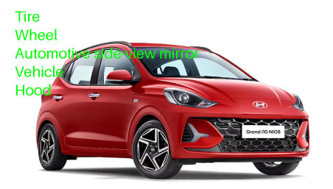
Step 11: Run inference
Open the Cloud Shell and type the following command:
(a) Label Detection
python label_detection_v2.py
gsutil cp label_detection_output.jpg gs://YOUR_BUCKET_NAME/output/

Slide 13
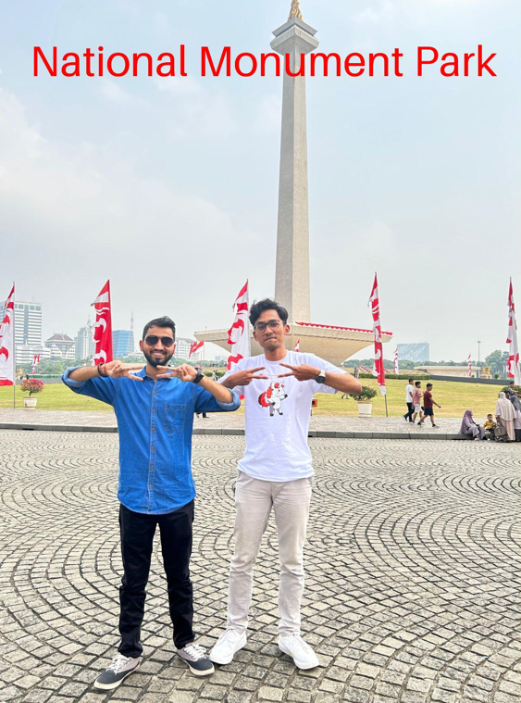
(b) Landmark Detection
python landmark_detection_v2.py
gsutil cp landmark_detection_output.jpg gs://YOUR_BUCKET_NAME/output/

Slide 14
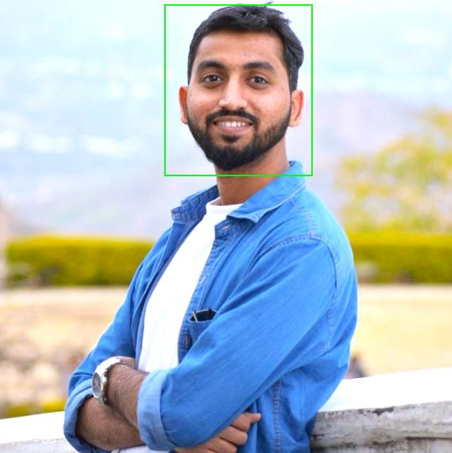
(c) Face Detection
python face_detection_v2.py
gsutil cp landmark_detection_output.jpg gs://YOUR_BUCKET_NAME/output/

Slide 15
Google Cloud Certifications

Slide 16
Google Cloud Certifications
Foundational
Associate
Professional
Collaborative role with technical professionals
No technical prerequisites
Fundamental understanding of Google Cloud
Experience deploying cloud applications and monitoring operations
Experience managing cloud enterprise solutions
In-depth experience setting up cloud environments for an organization
Experience deploying services and solutions based on business requirements
More info on:
https://cloud.google.com/learn/certification

Slide 17
How do I get started?

Slide 18
Fundamentals
Intermediate
Advanced
Machine Learning Specialization by DeepLearning.AI https://www.coursera.org/specializations/machine-learning-introduction
Generative AI Learning Path by Google https://www.cloudskillsboost.google/journeys/118
Deep Learning Specialization by DeepLearning.AI https://www.coursera.org/specializations/deep-learning
Computer Vision Fundamentals with Google Cloud https://www.coursera.org/learn/image-understanding-tensorflow-gcp
Official TensorFlow website https://www.tensorflow.org
Official Keras website https://www.keras.io
DeepLearning.AI TensorFlow Developer Professional Certificate https://www.coursera.org/professional-certificates/tensorflow-in-practice
TensorFlow: Data and Deployment Specialization https://www.coursera.org/specializations/tensorflow-data-and-deployment
Generative Adversarial Networks (GANs) Specialization https://www.coursera.org/specializations/generative-adversarial-networks-gans
Natural Language Processing Specialization https://www.coursera.org/specializations/natural-language-processing
MediaPipe Solutions https://developers.google.com/mediapipe
Kaggle Models https://www.kaggle.com/models
Machine Learning Engineering for Production (MLOps) https://www.coursera.org/specializations/machine-learning-engineering-for-production-mlops
Vertex AI – Google Cloud https://cloud.google.com/vertex-ai
Advanced Machine Learning on Google Cloud https://www.coursera.org/specializations/advanced-machine-learning-tensorflow-gcp
Production Machine Learning Systems https://www.coursera.org/learn/gcp-production-ml-systems
TensorFlow: Advanced Techniques Specialization https://www.coursera.org/specializations/tensorflow-advanced-techniques
Notes:
Audience split: 20% community, 55% devs, 25% partners
(expecting heavy overlap between comm and dev)

Slide 19
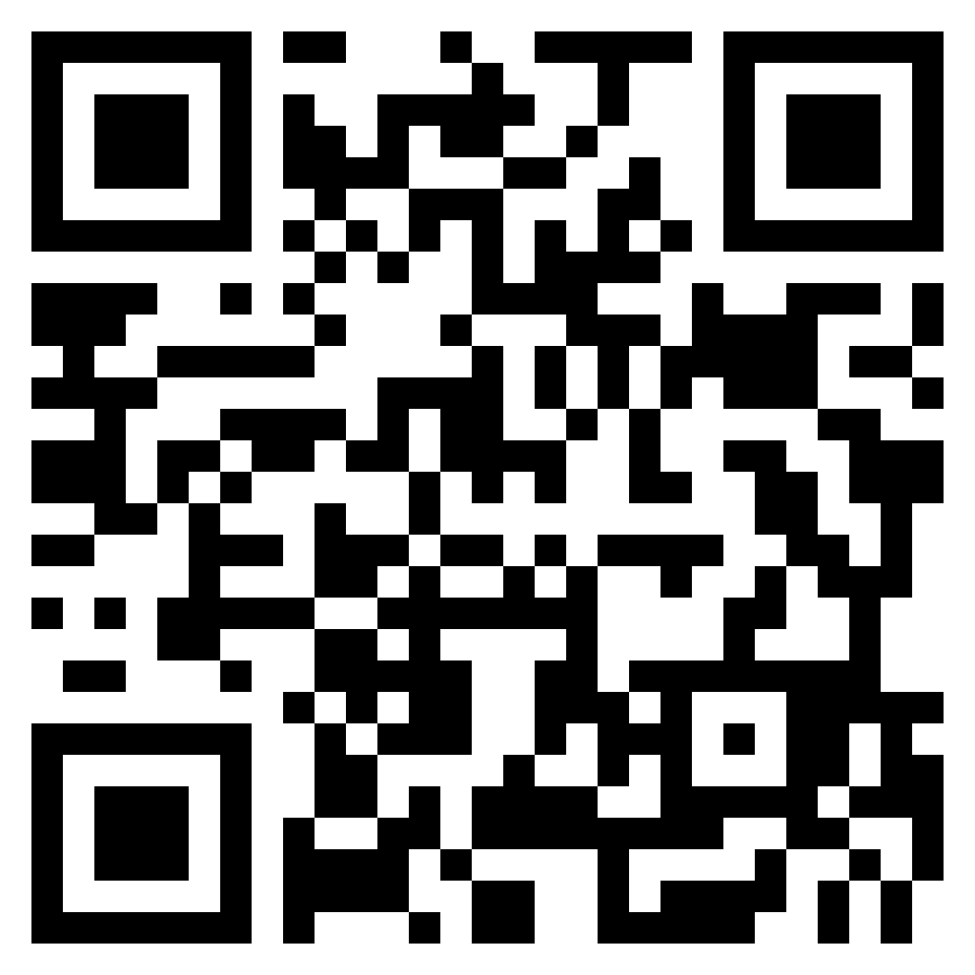



Thank You.
medium.com/@tiwarinitin1999
twitter.com/@NSTiwari21
github.com/NSTiwari

